Slide 1
FGED Views
OBI Workshop
La Jolla, CA
March 23, 2011

Slide 2

MGED is now the Functional Genomics Data Society
The Functional Genomics Data Society - FGED (eff – jed) Society, founded in1999 as the MGED Society, advocates for open access to genomic data sets and works towards providing concrete solutions to achieve this. Our goal is to assure that investment in functional genomics data generates the maximum public benefit. Our work on defining minimum information specifications for reporting data in functional genomics papers have already enabled large data sets to be used and reused to their greater potential in biological and medical research.
We work with other organizations to develop standards for biological research data quality, annotation and exchange.
We facilitate the creation and use of software tools that build on these standards and allow researchers to annotate and share their data easily.
We promote scientific discovery that is driven by genome wide and other biological research data integration and meta-analysis.
For more information see http://fged.org
Notes:
Functional genomics is more than expression profiling on microarrays and standards need to reflect that. This summer.
For recent example see PLoS Comp Bio paper Genome Standards Consorium, give examples

Slide 3

What is Functional Genomics?
From http://en.wikipedia.org/wiki/Functional_genomics
Functional genomics is a field of molecular biology that attempts to make use of the vast wealth of data produced by genomic projects (such as genome sequencing projects) to describe gene (and protein) functions and interactions. Unlike genomics and proteomics, functional genomics focuses on the dynamic aspects such as gene transcription, translation, and protein-protein interactions, as opposed to the static aspects of the genomic information such as DNA sequence or structures. Functional genomics attempts to answer questions about the function of DNA at the levels of genes, RNA transcripts, and protein products. A key characteristic of functional genomics studies is their genome-wide approach to these questions, generally involving high-throughput methods rather than a more traditional “gene-by-gene” approach.

Slide 4
Annotare - An open source standalone MAGE-TAB editor
Shankar R, Parkinson H, Burdett T, Hastings E, Liu J, Miller M, Srinivasa R, White J, Brazma A, Sherlock G, Stoeckert CJ Jr, Ball CA.
Annotare - a tool for annotating high-throughput biomedical investigations and resulting data.
Bioinformatics. 2010 Aug 23.
Notes:
In order to promote standards we recognized that we need to make it easier for people to use them. One effort is to build tools to help

Slide 5
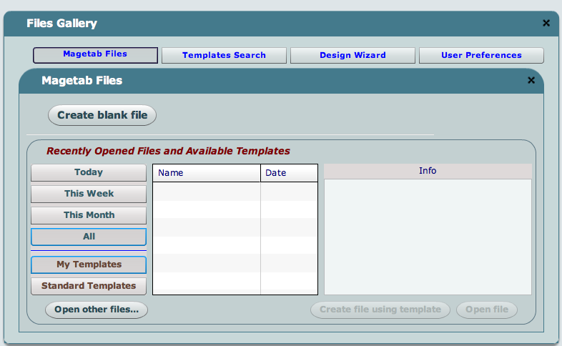
Annotare - an open source MAGE-TAB Editor
Annotare is an annotation tool for high throughput gene expression experiments in MAGE-TAB format. Researchers can describe their investigations with the investigators’ contact details, experimental design, protocols that were employed, references to publications, details of biological samples, arrays, and experimental data produced in the investigation.
Notes:
As a spreadsheet we typically start with a previous file that is similar and adjust – Annotare uses that approach to help you put in your info.

Slide 6
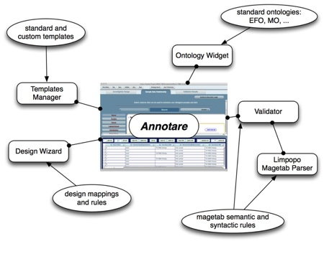
Annotare Features
Intuitive graphical user interface forms for editing
Ontology support, an inbuilt ontology and web services connectivity to bioportal
Searchable standard templates
Design wizard
Validation module
Mac and Windows Support
http://code.google.com/p/annotare/
Notes:
It also provides choices for terms, checks to see if the file has needed sections filled out and can be downloaded for free,

Slide 7
Annotation Using OBI (Exp: E-MEXP-1979)
Field Name | MO terms | OBI terms | Status
Experimental Design | ex_vivo_design | ex vivo design | pending approval
 | genetic_modification_design | genetic modification design | pending approval
 | co-expression_design |  | deprecate
 | replicate_design | replicate design | in OBI
 | transcription profiling by array (EFO) | transcription profiling by array design | pending approval
Experimental Factor Type | genotype | allele information | pending approval
Person Roles | submitter | reporting party role | in OBI
Protocol Type | nucleic_acid_extraction | nucleic acid extraction | in OBI
 | specified_biomaterial_action | specimen creation | in OBI
 | pool | pooling specimen | in OBI
 | labeling | labeling | in OBI
 | hybridization | nucleic acid hybridization | in OBI
 | feature_extraction | feature extraction | in OBI
 | bioassay_data_transformation | data transformation | in OBI
Characteristics [Age] | Age | age since birth measurement datum | in OBI
Characteristics [InitialTimePoint] | InitialTimePoint
 | birth
Characteristics [Sex] | Sex | biological sex | in OBI (PATO)
 | male | male | in OBI (PATO)
Characteristics [BioSourceType] | BioSourceType | specimen | in OBI
 | fresh_sample | fresh specimen | in OBI
Characteristics [Genotype] | Genotype | allele information | pending approval
 | wild_type | allele wild type | pending approval
Characteristics [Organism] | Organism | organism | in OBI
Characteristics [OrganismPart] | OrganismPart | anatomical entity | in OBI
Characteristics [DevelopmentalStage] | DevelopmentalStage | life cycle stage | in OBI (UBERON)
Characteristics [GeneticModification] | GeneticModification | genetic transformation | in OBI
 | gene_knock_out | gene knock out | in OBI
Notes:
Most of experiments can be annotated using OBI

Slide 8
FGED Needs
P41 HG003619 “Microarray data standards and supporting applications: MGED”
Aim 4. Provide biologist-friendly ontology terms that can be used to annotate microarray data.
Move MO and other needed terms into OBI
Provide labels that are biologist friendly
Provide an easy way to pull terms from OBI for use in MAGE-TAB
Using Annotare
Proposal:
use annotation properties to create FGED terms such as:
rdfs: editor preferred term: reporting party role
rdfs: community preferred term: FGED:submitter
Or rdfs: FGED preferred term: submitter
Use EFO for source of preferred term where it makes sense
Provide a FGED term for ALL terms of interest – may be same as editor-preferred term
Generate a FGED obi.owl of inferred obi.owl using FGED term as label and filtering out non-FGED terms.

